Slide 1
Rabin-Karp String Matching
Henry Chen, Amogh Ghadge, Yuyan Wang
Notes:
https://en.wikipedia.org/wiki/Rabin%E2%80%93Karp_algorithm

Slide 2
Content
Problem Formulation
Naive Approach
Rabin-Karp String Matching Algorithm
Other

Slide 3
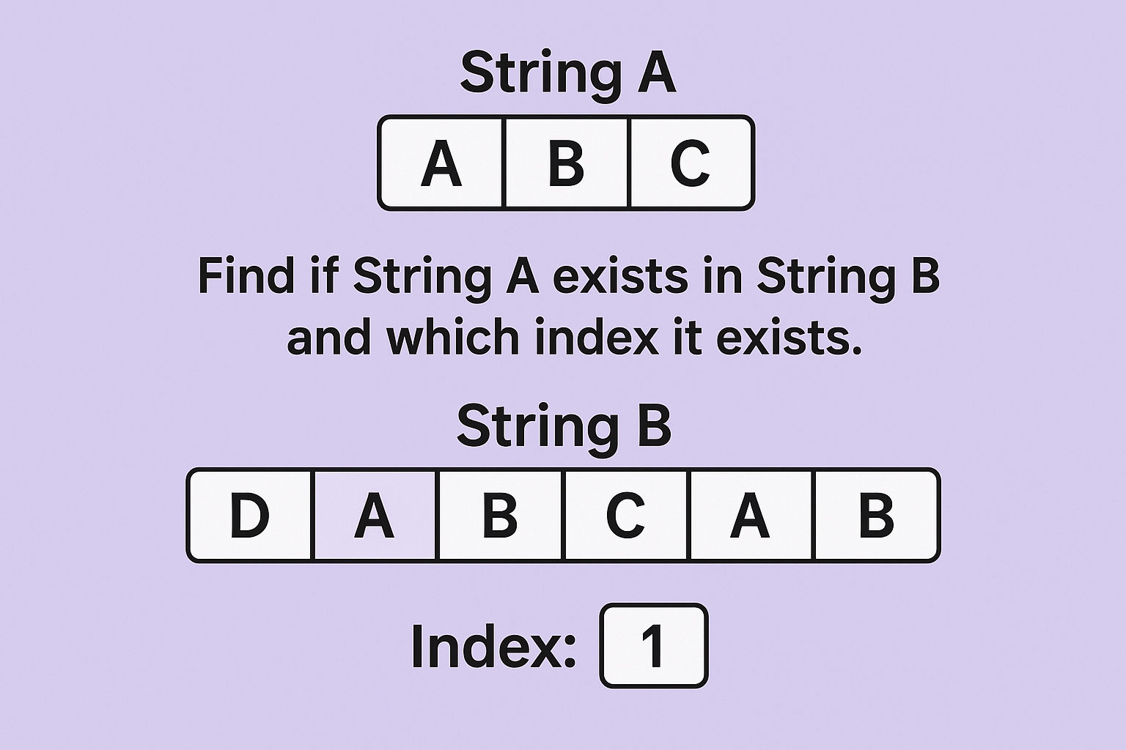
Problem Formulation
Problem: Find all occurrences of pattern in the text and return all indices they start at
Goal: Make the runtime faster than O(n*m), on average O(n+m).
n is the size of Text and m is the size of Pattern

Slide 4
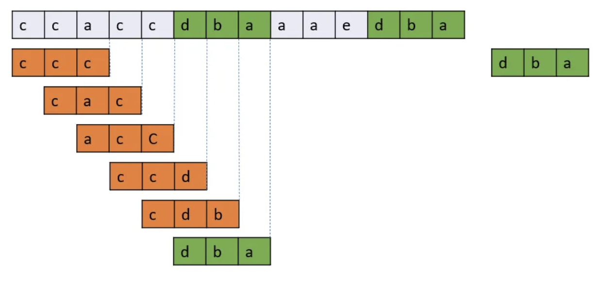
Naive Approach
Approach: Run through the String and check every possible substring.
Runtime: O(n*m) where the size of the string is N and the size of the pattern is M.

Slide 5
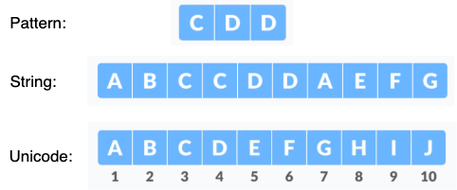
Simple Hashing String Matching
Let n be the length of the pattern and m be the length of the string.
Here, m = 10 and n = 3.
Assign each character a different integer value (unicode normalized from “A”).
Let the hash of any string be the sum of its character values
CDD = 3 + 4 + 4 = 11, ABC = 1 + 2 + 3 = 6
Manually verify strings are equal when hash of pattern = hash of current window

Slide 6
Simple Hashing String Matching
n = len(s)
pw = len(pattern)
unicode = {'a' : 1, 'b' : 2, 'c' : 3, 'd' : 4} #can be modified
def get_hash(window):
return sum([unicode[char] for char in window])
res = []
pattern_hash = get_hash(pattern)
for i in range(n-pw+1):
if get_hash(s[i:i+pw]) == pattern_hash and s[i:i+pw] == pattern:
res.append(i)
print(res)
Problem:
Duplicate hashes can be possible
“c” would have the same hash value as “aaa”
Hash is computed from scratch for every new window
Runtime: O(n * m)

Slide 7
Rabin-Karp String Matching Algorithm
What Rabin-Karp improves?
Improves hashing by encoding characters in accordance with their order.
Avoids collisions where 2 strings have equal hashes but not the same value (“ad” and “bc”)
Computes hashes of new windows faster by utilizing the last hash value.
Variables:
T → the Text that we are going to find the pattern
d → number of possible characters in string space
q → a large prime number
S → substring with length m
U→ unicode of all characters

Slide 8

Hash Function
Where:
S is the substring with length m (length of pattern)
uS[i] is the Unicode of character at S[i]
d is the base
q is used to prevent integer overflow
set to a large prime number to avoid collisions

Slide 9
Hash Function: Example
Where:
S is the substring with length m
uS[i] is the Unicode of character at S[i]
d is the base
q is a large prime
s1 = “acc”
hash(s1) = (‘c’ - ’a’ + 1) * 26^0 + (‘c’ - ’a’ + 1) * 26^1 + (‘a’ - ’a’ + 1) * 26^2
= 3 * 26^0 + 3 * 26^1 + 1 * 26^2
= 757
s2 = “cac”
hash(s1) = (‘c’ - ’a’ + 1) * 26^0 + (‘a’ - ’a’ + 1) * 26^1 + (‘c’ - ’a’ + 1) * 26^2
= 3 * 26^0 + 1 * 26^1 + 3 * 26^2
= 2057

Slide 10

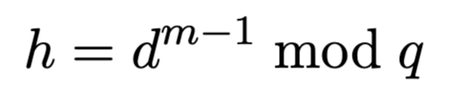
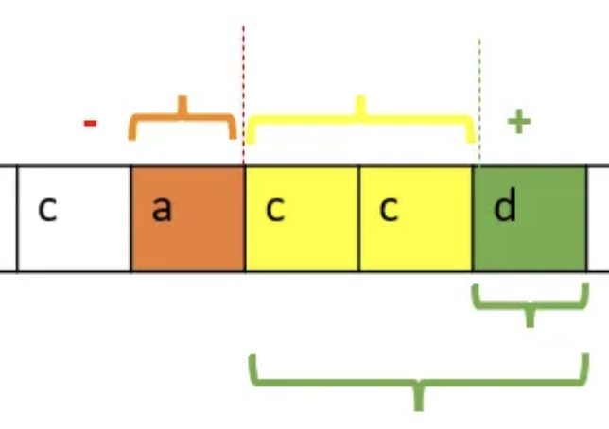
Rolling Hash
Where:
hash is the hash value of substring
d is the base
u is the Unicode of all possible char
h is the highest order coefficient
q is a large prime

Slide 11
Rolling Hash: Example
Where:
hash is the hash value of substring
d is the base
u is the Unicode of all possible char
h is the highest order coefficient
q is a large prime
Hash of “acc” is 757
Unicode of “a” = (ord(“a”) - ord(“a”) + 1) = 1
Unicode of “d” = (ord(“d”) - ord(“a”)+ 1) = 4
d = 26
h = 26 ^ 2
Substring is represented by a three digit base 26 number
q = 10^ 9 + 7
New Hash = (26 * (757 - 1 * 26 ^ 2) + 4) mod (10^ 9 + 7)
New Hash = 2110

Slide 12
Pseudocode
# find all indices in the text that match the pattern
def rabin_karp(text, pattern):
indices, base, q, target_hash, curr_hash, l = [], 26, 10**9 + 7, 0, 0, 0
# Compute the hash of the pattern
for i in range(len(pattern)):
# Go in reverse of pattern
target_hash = (target_hash * base + (ord(pattern[i]) + 1)) % q
# Sliding window
for r in range(len(text)):
curr_hash = (curr_hash * base + (ord(text[r]) + 1)) % q
# Rolling hash update
if r - l + 1 > len(pattern):
curr_hash = (curr_hash - (ord(text[l]) + 1) * pow(base, len(pattern), q)) % q
l += 1
# Check if the current window matches the pattern
if r - l + 1 == len(pattern) and curr_hash == target_hash:
if text[l:r+1] == pattern:
indices.append(l)
return indices
Notes:
Amogh

Slide 13
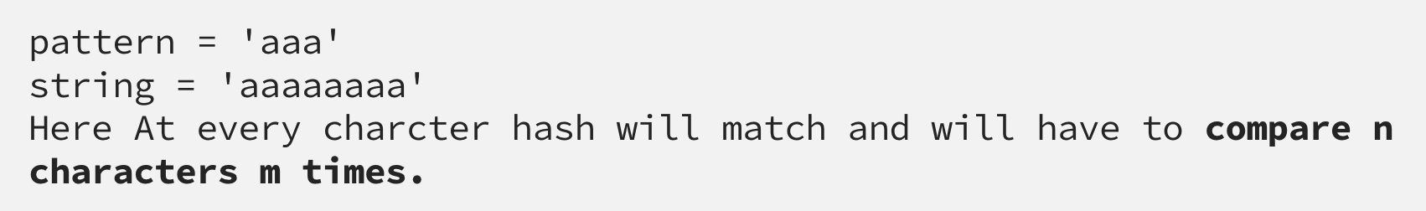
Time Complexity
Complexity:
Spurious hits are when the hash value of the pattern matches with the hash value of a window but the content of the window is not equal to the pattern
Occurs as a result of modding by q
Require manual check when hashes equal
The average case and best case complexity of Rabin-Karp algorithm is O(m + n) and the worst case complexity is O(mn).
Worst case occurs when pattern matches every window in the text

Slide 14
Summary
Complexity:
The average case and best case complexity of Rabin-Karp algorithm is O(m + n) and the worst case complexity is O(mn).
The worst-case complexity occurs when the pattern matches every window
Limitations:
Because spurious hits can occur, a manual check is needed to ensure that when hashes match, the contents of the window actually match the pattern. As a result, if the pattern matches every window, it is possible that this algorithm has an O(mn) runtime.

Slide 15
Even Better?
Monte Carlo Variant
Uses several hash functions to probabilistically confirm matches.
Reduces the chance of collisions while keeping performance fast, though there's a small chance of false positives
Knuth–Morris–Pratt
Preprocesses the pattern to create a partial match (prefix) table.
Skips unnecessary comparisons when a mismatch occurs.
Boyer–Moore
Leverages heuristics to shift the search window by more than one position on mismatches.
Often results in sub-linear average-case performance, especially for large alphabets.

